Slide 1
Data Analysis on Good Health - UN SDG Goal 3
Notes:
Good Afternoon everyone. My name is Avani and I am going to present data analysis on Goal 3: Good Health

Slide 2
Agenda
In this powerpoint presentation, I will be walking through some of the health concerns raised by UN as its part of SDG, here are those listed below.
REDUCE
Neonatal & Child Mortality
Maternal Mortality
Infectious diseases
Non Communicable Disease
Substance abuse and Road injuries
ACHIEVE
100% Vaccination
Achieving Universal Health Coverage
Understanding Canada’s Situation on SDG 3
Call for Action
Notes:
In this powerpoint presentation, I will be walking through some of the health concerns raised by UN for SDG 3, here are those listed below.

Slide 3

Hello,
I’m “Barbie”
Notes:
I would like to start this analysis with a beautiful character named “Barbie”.

Slide 4
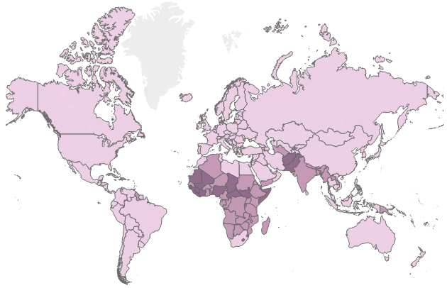
Imagine if “Barbie” was born in “Sub-Saharan Africa”
Neonatal mortality rate under age 1, 2020
Her chances of death could be 9X times higher then the high-income country.
Globally 4% of all children die before reaching the age of five, which means that on average 15,000 children die every day.
Sub-Saharan Africa has the Highest neonatal mortality rate (27 deaths per 1000 live births), resulting in 43% of global newborn deaths.
22.5
Notes:
Imagine if barbie was born in “Sub-Saharan Africa” Her chances of death could be 9 times higher compared to high income country. That means everyday 15000 children die before they turn 5. From the map we can clearly see the highest % death result from sub-saharan africa which is 43%.

Slide 5
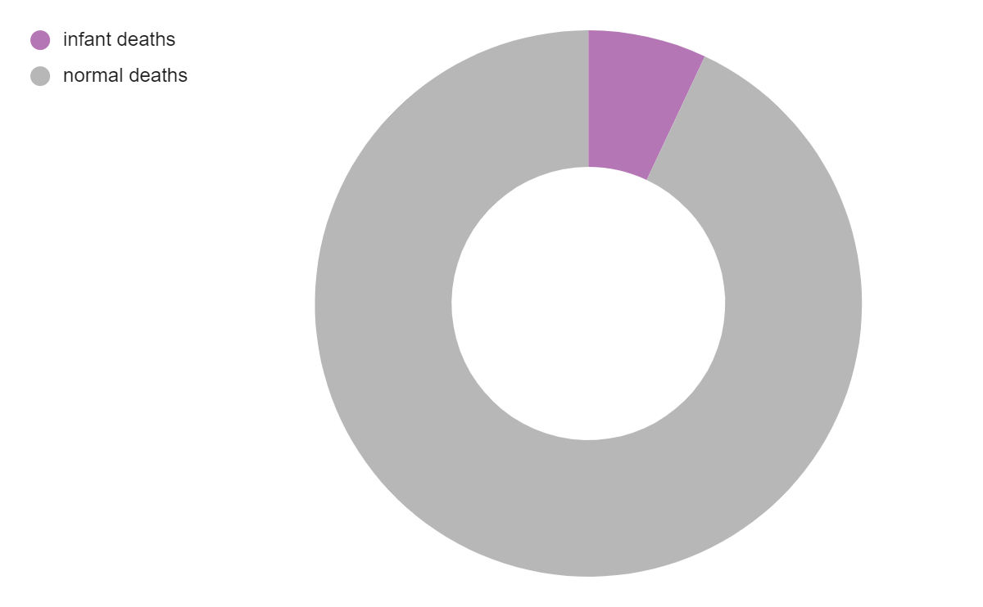
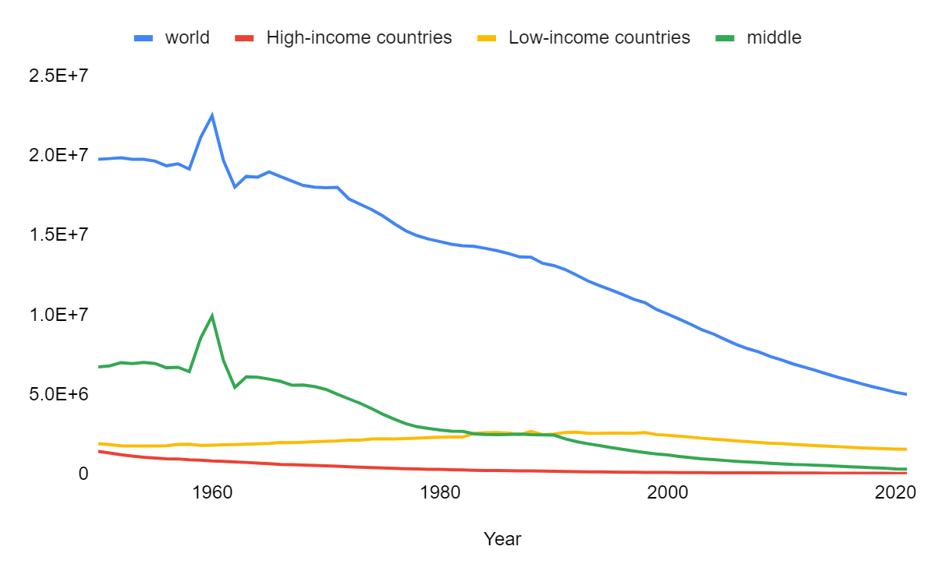

“Neonatal & Child Mortality”
Global Neonatal and Under 5 child mortality rate over the years
7%
74% Decline
Infant & Child Mortality accounts for 7% of all losses worldwide,
Pneumonia
Diarrhea
Malaria
are the main killers.
As per SGD 3, by 2030 our target is to bring these mortalities less 2.5%, which mean we need to achieve less than 9000 deaths per day. To accomplish it, we need 3.5% reduction each year.
Notes:
Speaking of neonatal and child mortality, it accounts for 7% of overall losses worldwide. But the good news is there has been a 74% of decline till no. But that’s not it, comparing the SDG 3 target for good health we still need 3.5% reduction each year. Our target is to achieve less than 9000 deaths per day.

Slide 6
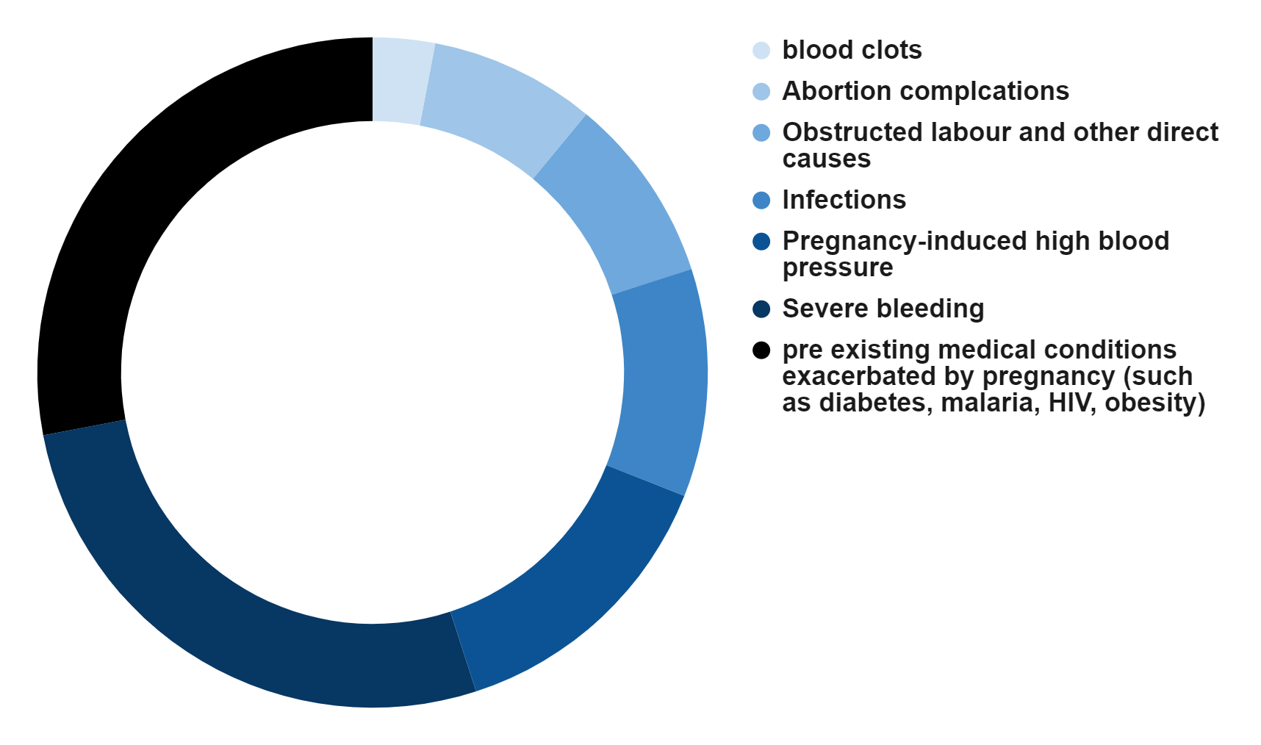
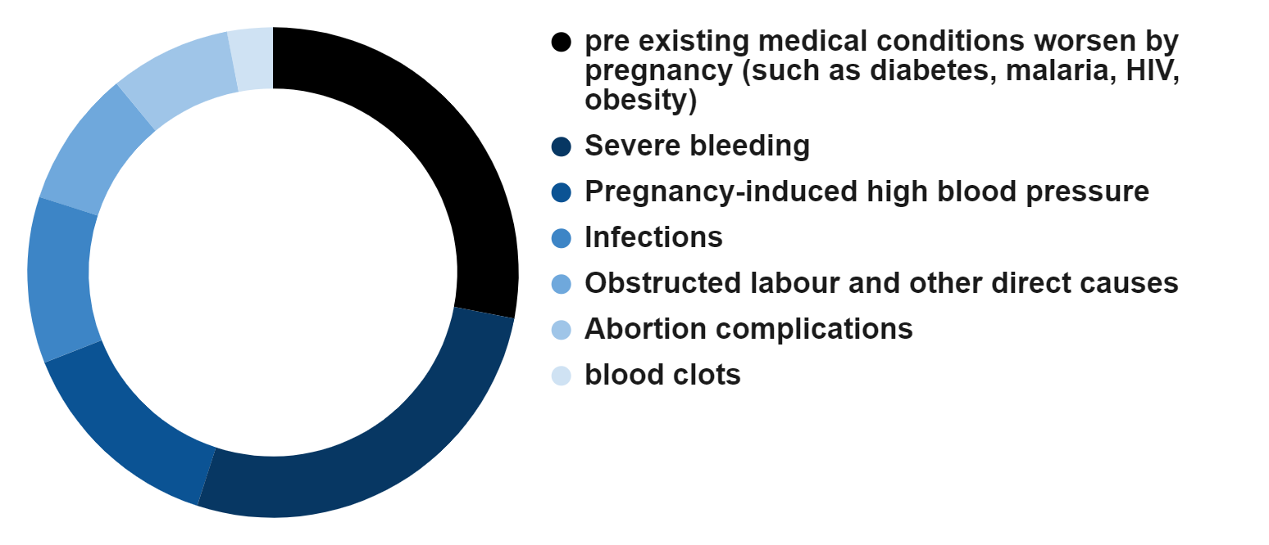

Also, lets not forget the fight against
“Maternal Mortality”
that “Barbie’s Mum” had.
3%
So, what are pregnant women DYING from ?
8%
28%
9%
11%
27%
14%
Notes:
Moving ahead, lets not forget the fight against maternal mortality that barbie’s mum had. The below pie chart represent the percentage prevalence of the diseases causing mortality due to pregnancy. The major reason to death is per existing medical conditions which caused 28% of deaths world wide, and least is blood clotting. However, let not forget whatever the reason is, for us every “mother’s live matter”.

Slide 7
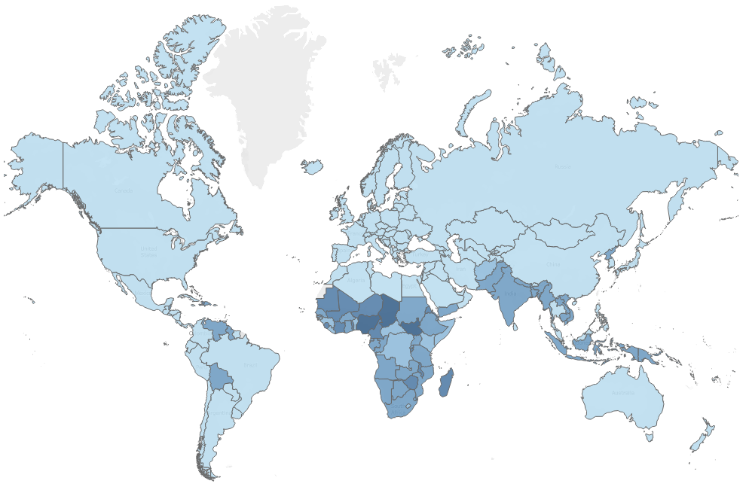
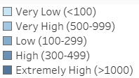

Maternal Mortality
…Let talk around the “Globe”….
Countries with highest MMR(over 100k live births) is found in
South Sudan (1150)
Chad (1,063)
Nigeria (1,047)
Do you know?
94% Maternal Mortality Rate occurs in low income country.
World map for 2017 - Maternal mortality ratio (per 100,000 lives births)
Notes:
Here is a world map to give us an insight about the countries where the maternal mortality is most prevalent. According to survey, 94% of mortality occurs in low income countries, where South Sudan, Chad and Nigeria are those 3 countries with highest MMR.

Slide 8
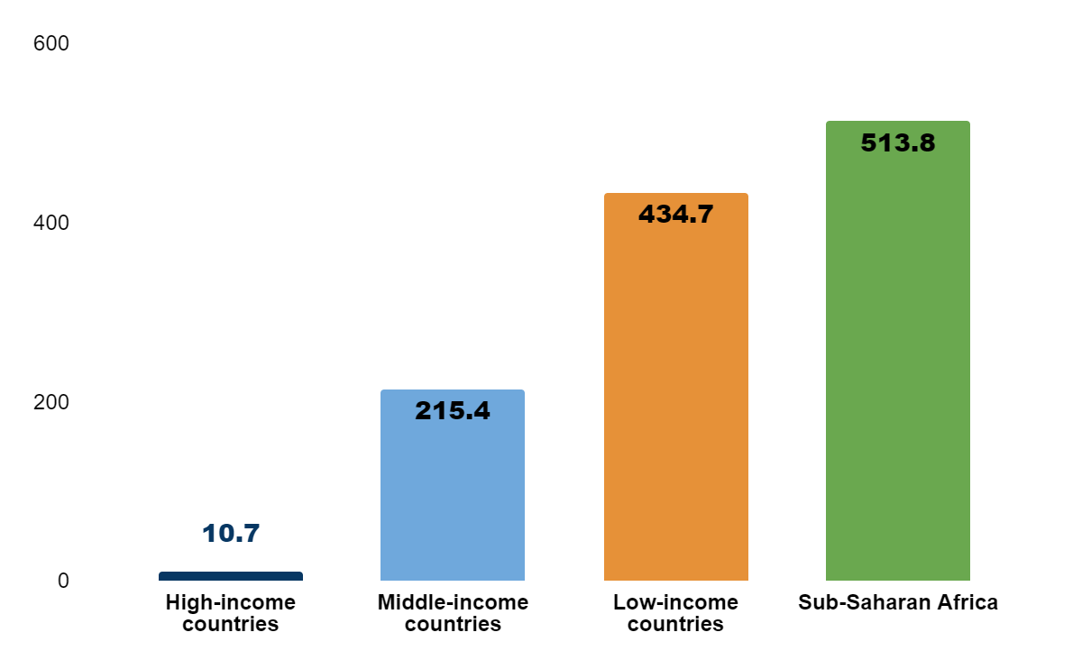
Maternal Mortality
Do you know?
In 2020, One woman died every 2 minutes due to pregnancy.
Low-income countries: MMR of 430 per 100,000 live births.
High-income countries: MMR of 12 per 100,000 live births.
Global MMR in 2020: 223 per 100,000 live births.
Fortunately, from 2000 to 2017 there have been a 62% decline in maternal mortality.
Maternal mortality ratio in high, middle, low-income & Sub-Saharan Africa countries
To achieve SGD-3, by 2030, for global MMR below 70 by 2030, will require an 11.6% annual reduction rate.
Notes:
Moving ahead, this bar graph shows how maternal mortality rates (MMR) vary based on a country's income level. At this point I would ask you to please have a look on the numbers highlighted from the graph. Fortunately from 2000 to 2017 there has been a 62% decline in these deaths. As we can see our current Global MMR is 223 per 100k live births, which need to be reduced to 70 by 2030, so that means we need 11% reduction every year.

Slide 9

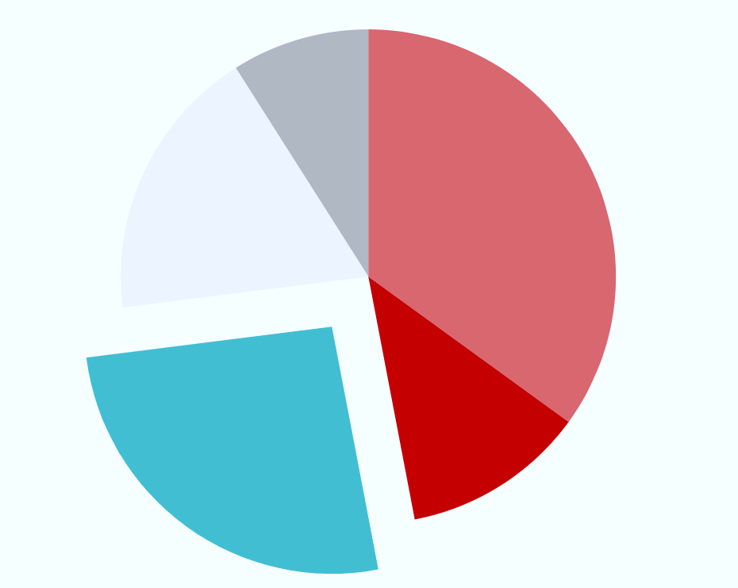
Luckily “Barbie” survived her childhood and now she is a growing adult…
But hope she realises, it still not safe for her, especially with “Infectious diseases”.
Every year 13.7 million people died worldwide from infectious syndromes.
Malaria, tuberculosis, HIV/AIDS, hepatitis, and influenza are major communicable diseases impacting public health and economies worldwide.
Injuries
9%
Others
10%
Cardiovascular Diseases
35%
Infectious Diseases
26%
Cancers
12%
Causes of Mortality in 2005
Notes:
Luckily “Barbie” survived her childhood and now she is a growing adult. But hope she realises, it still not safe for her, especially with “Infectious diseases”. That's because 26% of deaths worldwide are caused by infectious diseases(as we can see from the pie chart), which amounts to approximately 13.7 million deaths. And the major diseases behind these deaths are, malaria, tuberculosis, HIV/AID, hepatitis and influenza. Thus by 2030 UN wants to end epidemics from infectious disease.

Slide 10
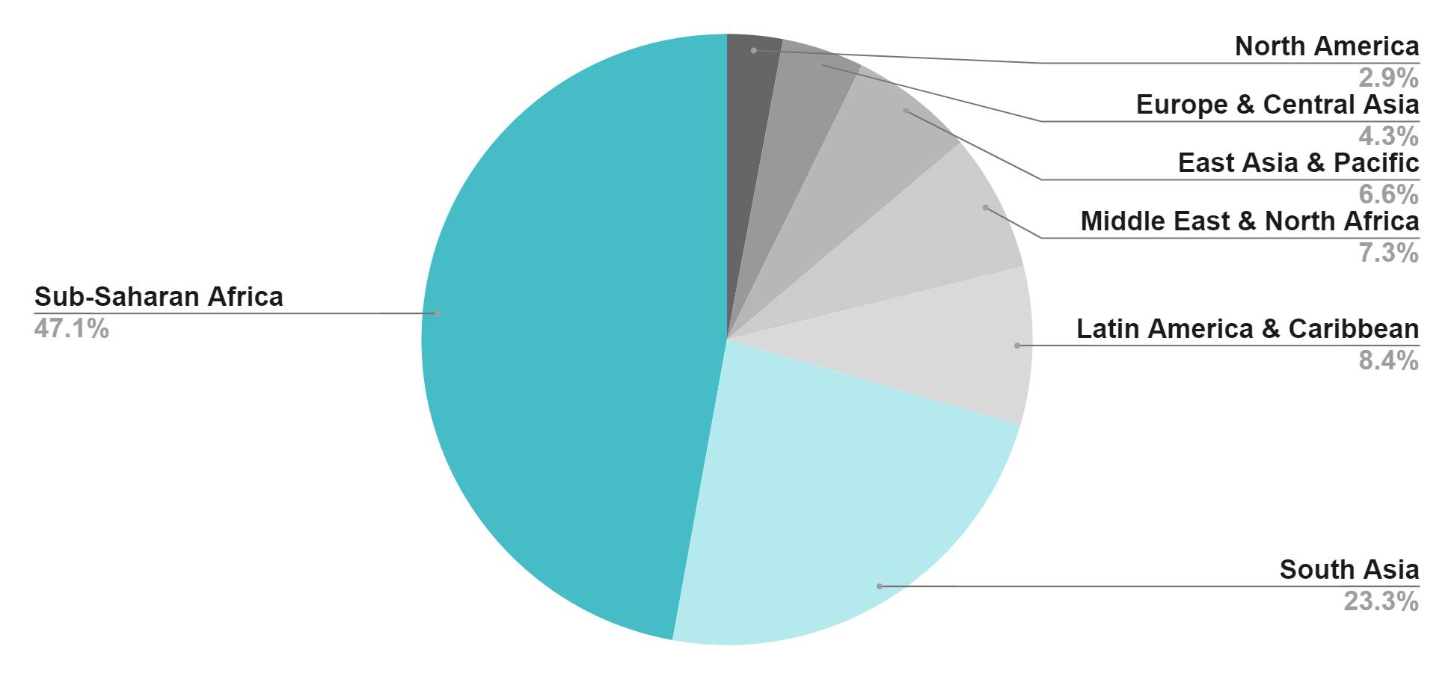
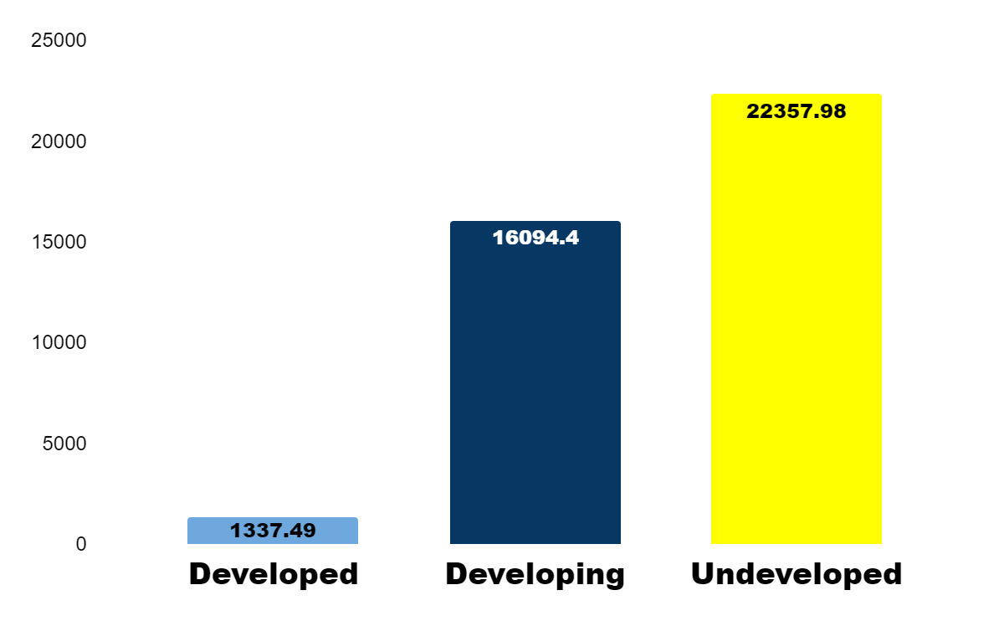
Where are mortalities most prevalent for “Infectious diseases”.around the “Globe”?
56.2%
40.4%
3.6%
70%
Bar Chart comparing prevalent cases on development disparities.
Notes:
Returning to the global perspective , the pie chart answers the question by revealing that Sub-Saharan Africa and South Asia account for 70% of all deaths. The majority of these deaths occur in underdeveloped countries, with developing countries following closely behind. Together they accounts for 96% of deaths.

Slide 11
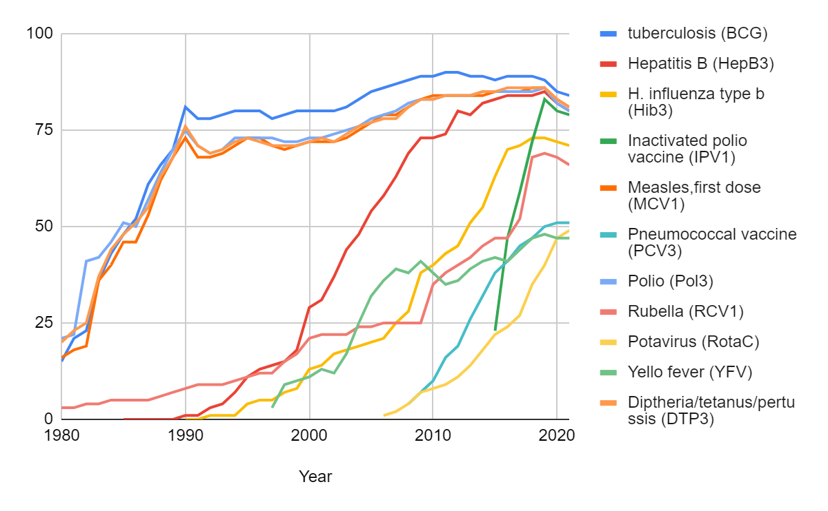
But do we know…..
vaccination rates
poorer countries < 50%, while,
richer countries > 90% vaccination coverage because they have stronger immunization programs.
This falls short of the recommended global target of 80% coverage.
It was tough to recover, but Barbie is fine just cause she was “vaccinated” with all of the below……
Fig 8 :Global Vaccination Coverage from 1980 - 2021
Do you know?
Immunization can prevent approximately 2-3 million deaths every year.
Notes:
It was tough to recover, but Barbie is fine just cause she was “vaccinated” with all of the below. But do we know Many poorer countries have vaccination rates below 50%, while richer countries typically exceed 90% vaccination coverage because they have stronger immunization programs. This falls short of the recommended global target of 80% coverage. Through immunisation we can prevent approximately 2-3 million deaths each year.

Slide 12
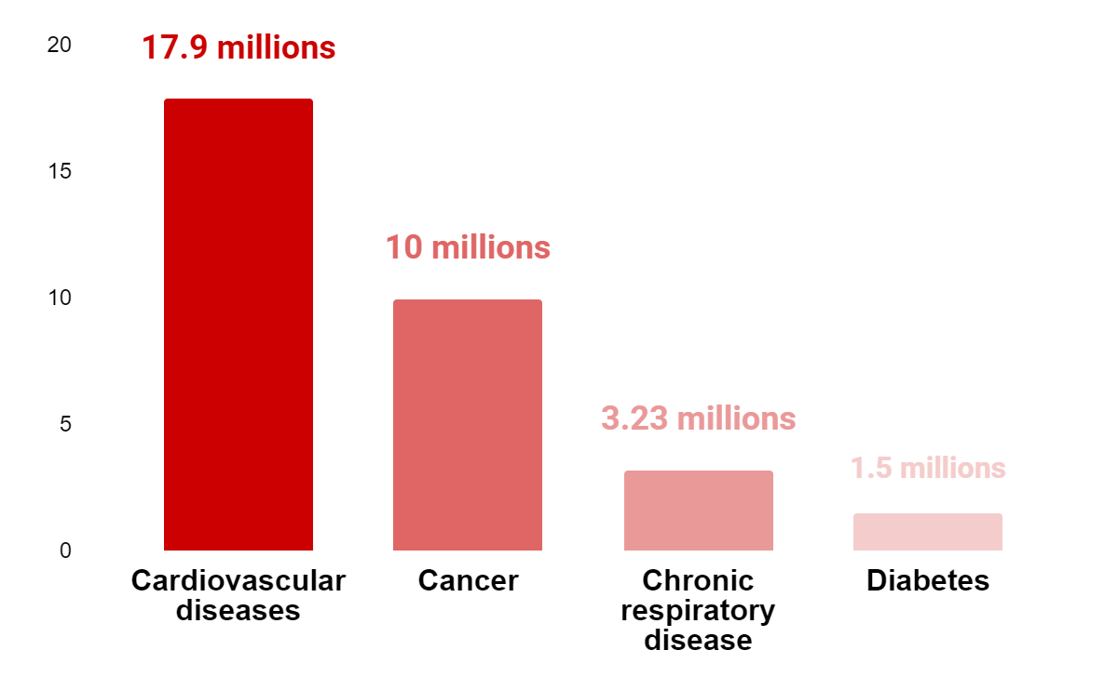
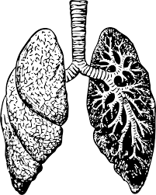

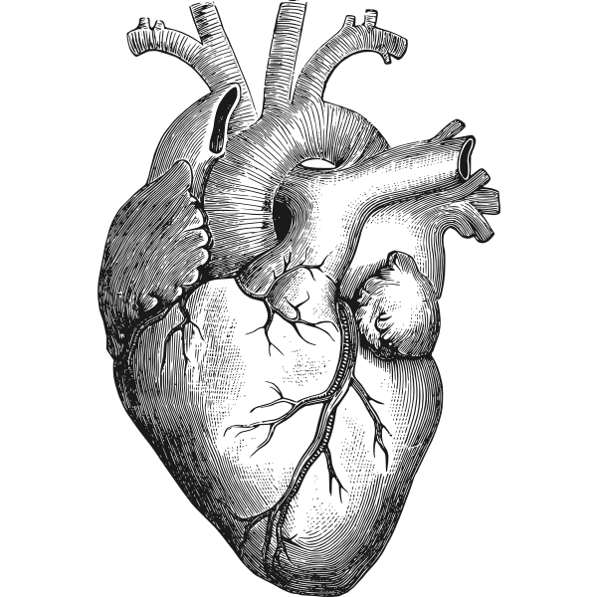

…and now let's talk about other prevalent diseases like
“Non- communicable diseases”
that might exist in her community.
Do you know?
NCDs are top cause for deaths globally about (74.3%) each year.
About 85% of these “premature” deaths occur in low and middle-income countries.
Four major risk factors causing NCDs : tobacco use, physical inactivity, Alcohol and unhealthy diets.
Notes:
…and now let's talk about other prevalent diseases like “Non- communicable diseases” that might exist in her community. Do you know non communicable diseases are the top cause of global deaths resulting in more than 30 millions mortalities, which is equivalent to 74% of all deaths. About 85% of these “premature” deaths occur in low and middle-income countries. Major risk factors causing NCD’s are tobacco use, physical in-activities, Alcohol and unhealthy diets.

Slide 13


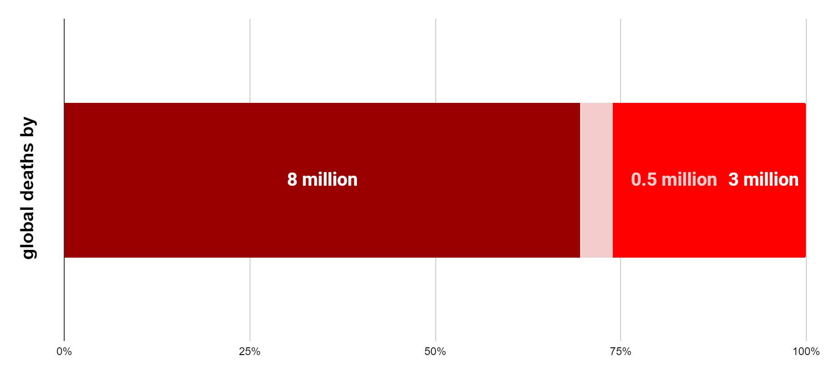
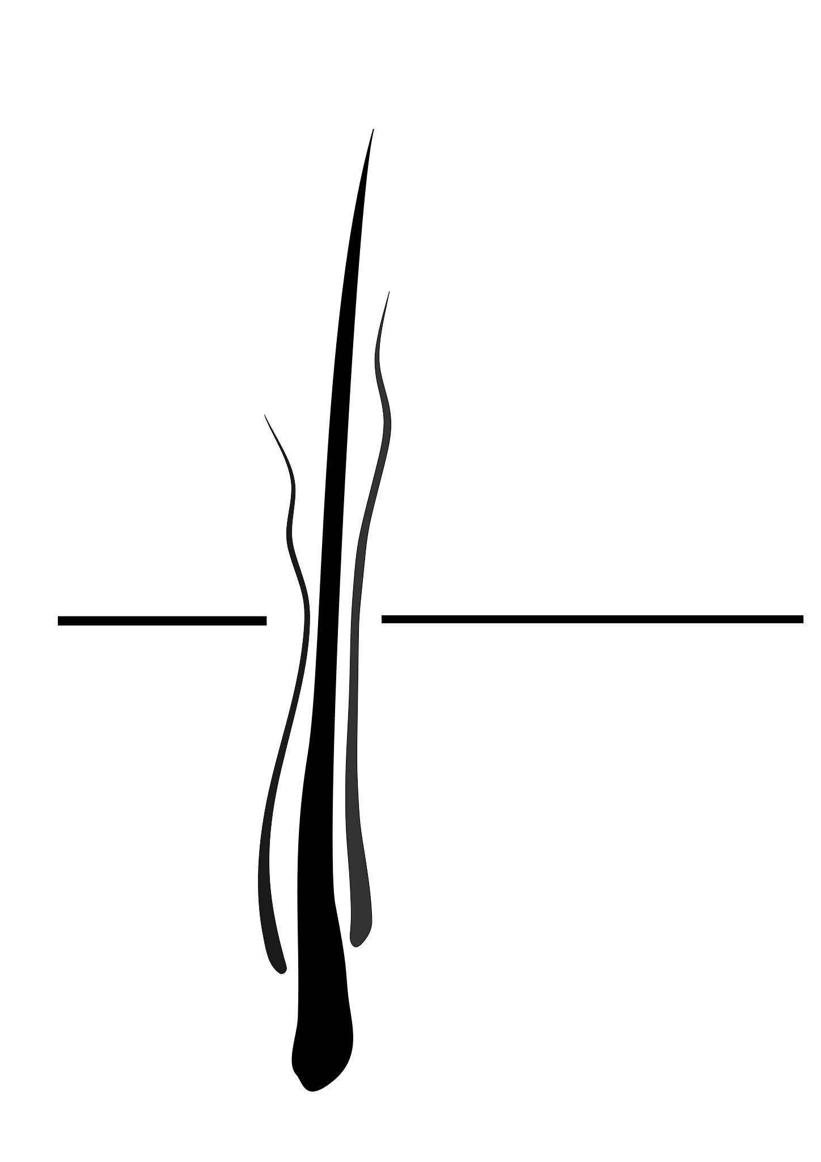




Now, lets understand, how can bad habits cause “mortalities”
Which means, Alcohol is responsible for 5% of the global deaths
Around 80% of the world's tobacco users live in low- and middle-income countries
Tobacco
Alcohol
Drug overdose
About 25% of those deaths caused by opioid overdose, out of which 21% happens in USA.
Note: Out of 1.2 million annual road fatalities worldwide, 21% happens just cause of drinking and driving.
Source: www.who.com, www.cdc.gov
Notes:
Now that we understand how risk factors like tobacco and alcohol affect our lives, let's explore them in more detail. The graph on this slide illustrates global mortality caused by tobacco, drug overdoses, and alcohol. Alcohol is responsible for 5% of global deaths and 21% of road fatalities worldwide. About 80% of worlds tobacco users live in low and middle income countries. Talking drug related deaths, about 25% of drug overdose is caused by opioid, out of which 21% happens in USA.

Slide 14
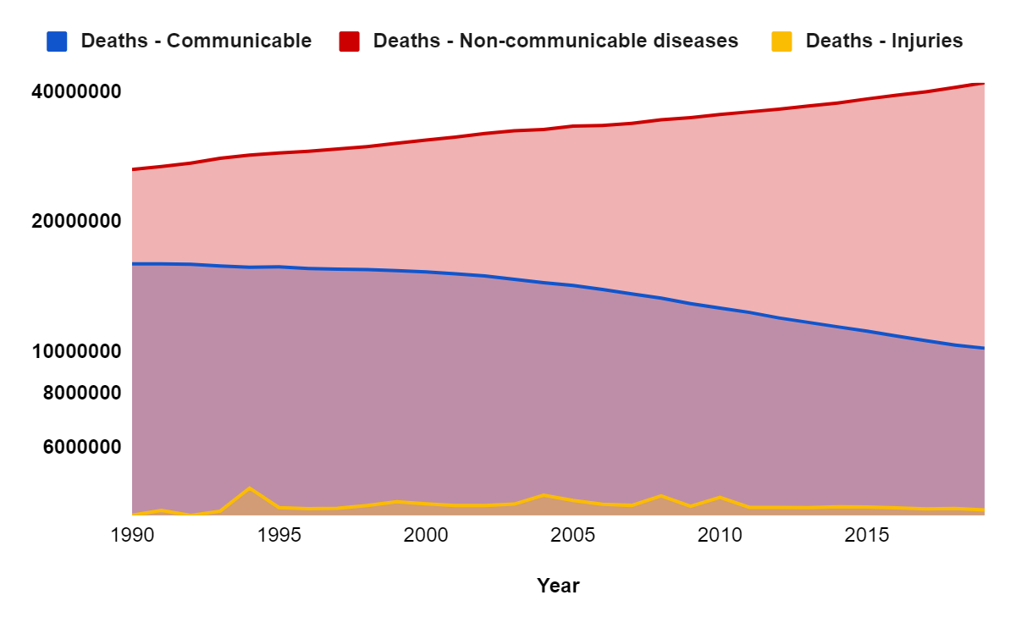
Projected trends in cause of deaths globally
58% increase
56% decline
Notes:
This slide provides an overview of the current situation regarding major diseases. It's evident that communicable diseases have been decreasing over the years, while non-communicable diseases are on the rise, which is a cause for concern.

Slide 15
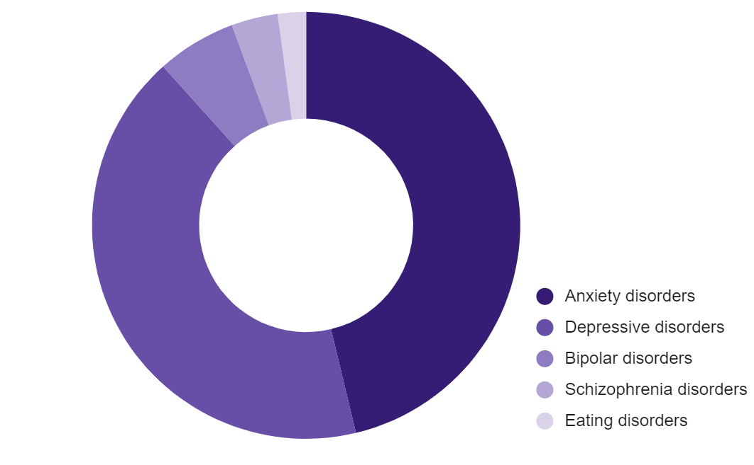

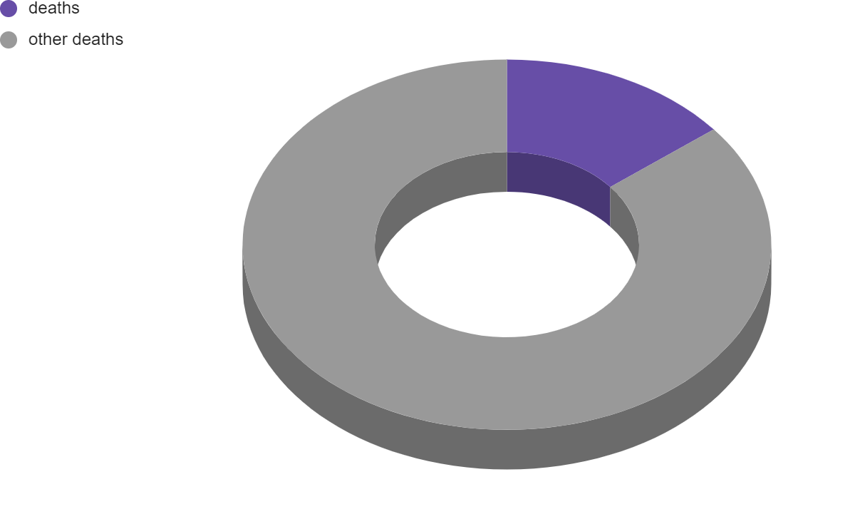




Prevalence of Mental Illness, globally 2019
2.1%
As health and economic burdens persist, “Barbie” now has begun to explore its influence on
“Mental Health”
3.5%
6%
Currently, its 450 million of us are struggling with mental illness.
46.3%
42.1%
Resulting in 8 millions deaths, each year
14.3%
Do you know?
&
will experience major depression in their lives
Notes:
As health and economic burdens persist, “Barbie” now has begun to explore its influence on“Mental Health”. Moving with the facts, Currently, its 450 million of us are struggling with mental illness, which is resulting in 8 millions deaths each year. The right donut chart shows prevalence percentage of mental illness, with anxiety and depression the leading cause of illness. Do you know? 1 in 3 women and 1 in 5 men will experience major depression in their lives.

Slide 16
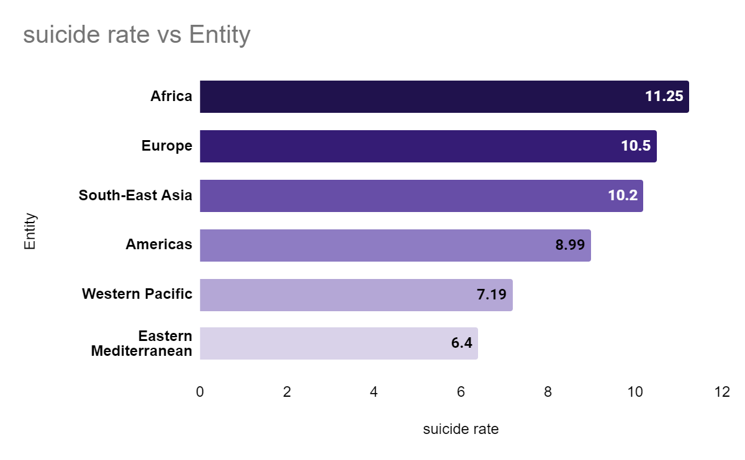
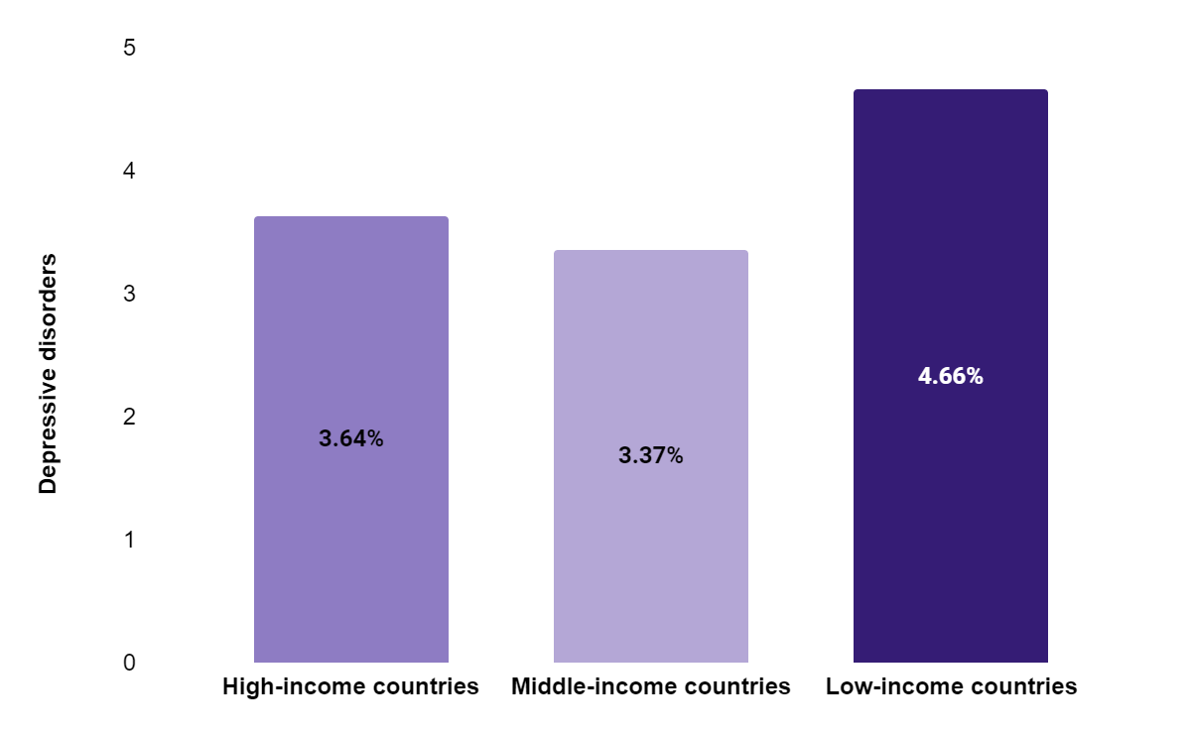
Mental Health
Depression can lead to suicide.
Globally, an estimated 5% of “adults” suffer from depression.
More women are affected by depression than men.
Depressive disorder % prevalence in high , middle and low income countries, 2019
Suicidal rate in 2019 comparing continents
source:https://www.who.int/news-room/fact-sheets/detail/depression
Notes:
Talking more about mental health, Globally, an estimated 5% of “adults” suffer from depression. More women are affected by depression than men. The left bar chart highlights that low-income countries have higher cases of depression. Depression can be linked to suicide. The right chart compares suicide rates across continents, with Africa having the highest rate.

Slide 17

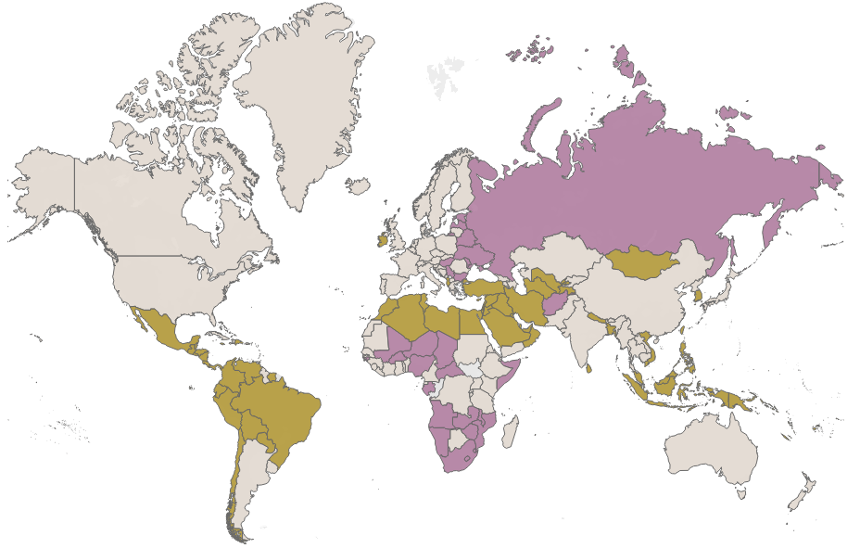

With all the mortality and infection, “Barbie” questions ?, why only her country more suffering?
Do you know?
In low-income countries, 60% of health-related deaths are due to poor care, and the rest are from not using the healthcare system.
World Death Rate
9.39
Source: https://platform.who.int/mortality/themes/theme-details/MDB/all-causes
Notes:
With all the mortality and infection, “Barbie” questions ?, why only her country more suffering? Do you know ? In low-income countries, 60% of health-related deaths are due to poor care, and the rest are from not using the healthcare system.

Slide 18
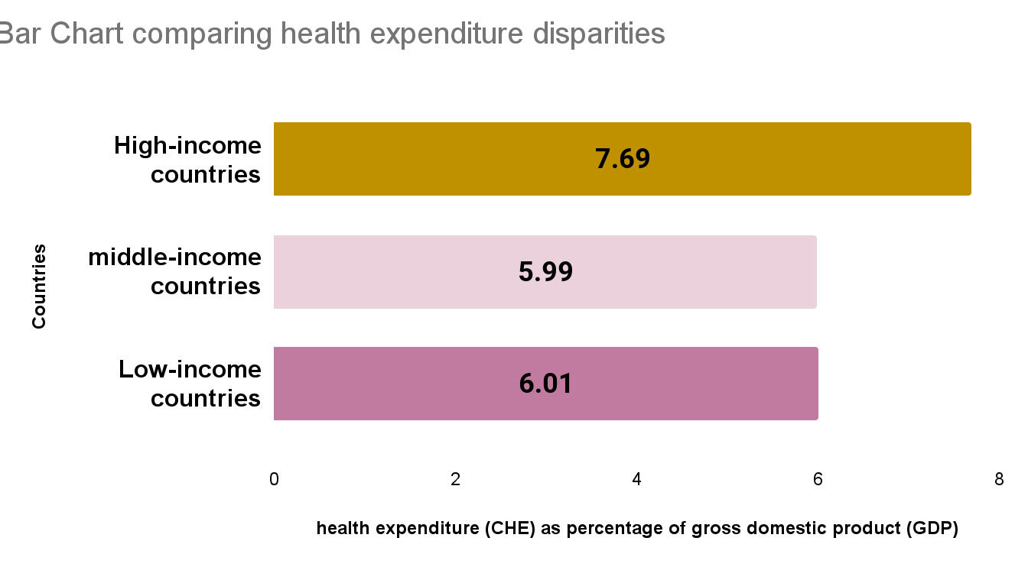
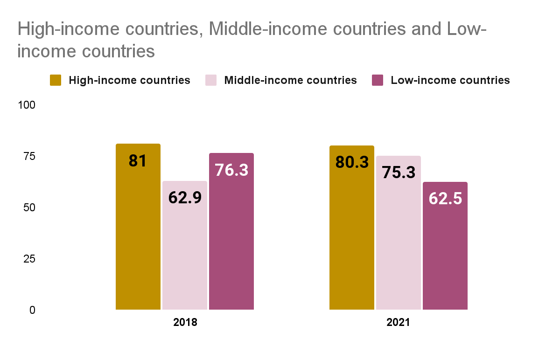

That’s because, High income countries have better
“Access to Healthcare”
compared to Middle and Low income countries
Comparing health expenditure disparities
Life expectancy
Notes:
That’s because, High income countries have better “Access to Healthcare” compared to Middle and Low income countries.
In this slide, the two bar charts illustrate the relationship between health expenditure and life expectancy. A stronger healthcare system typically leads to higher life expectancy.

Slide 19

That means, Countries with “well-organized” healthcare systems experience lower mortality rates compared to those which are developing/underdeveloped.
To overcome this, United Nations want by 2030 to,
Achieve universal health coverage
Financial Security: No one faces heavy healthcare costs.
Quality Care: Access to good healthcare services.
Affordable Medicines: Safe, effective, and affordable medicines and vaccines for all.
Do you know?
As of 2021, at least half of the world's population still lacks access to essential health services.
Notes:
Since now it's clear that, Countries with “well-organized” healthcare systems experience lower mortality rates compared to those which are developing/underdeveloped. To overcome this, United Nations want by 2030 to, Achieve universal health coverage, including financial risk protection, access to quality essential health-care services and access to safe, effective, quality and affordable essential medicines and vaccines for all. Do you know? As of 2021, at least half of the world's population still lacks access to essential health services.

Slide 20

“Barbie” now values life and plans move to Canada for studying medicine, as her dream is improve her home country’s living standard.
Notes:
“Barbie” now values life and plans move to Canada for studying medicine, as her dream is improve her home country’s living standard.

Slide 21
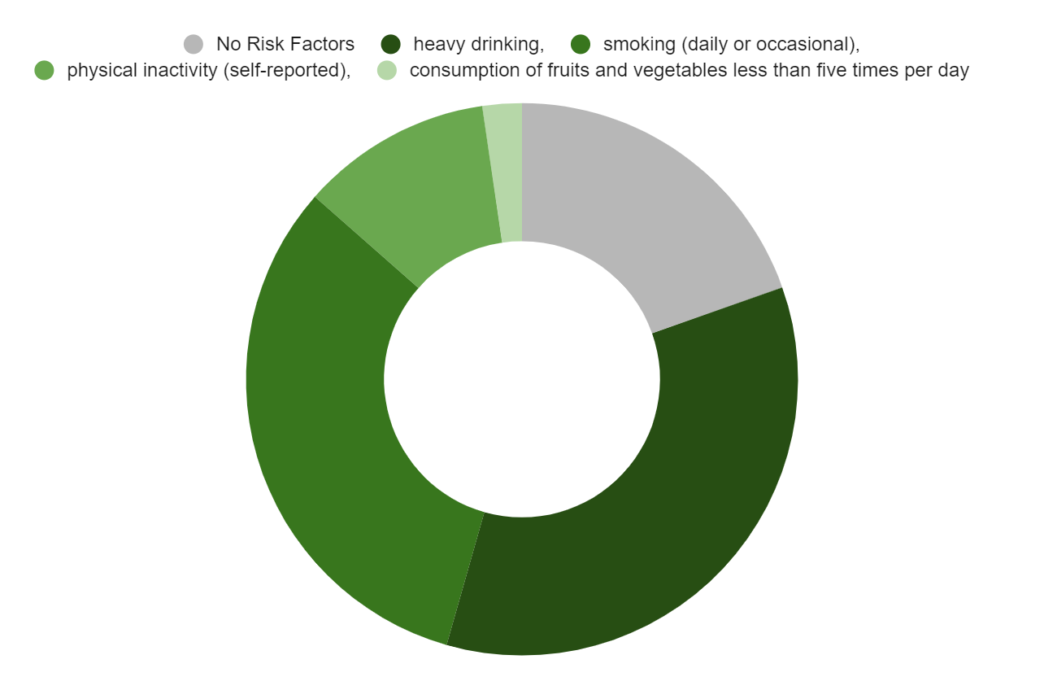
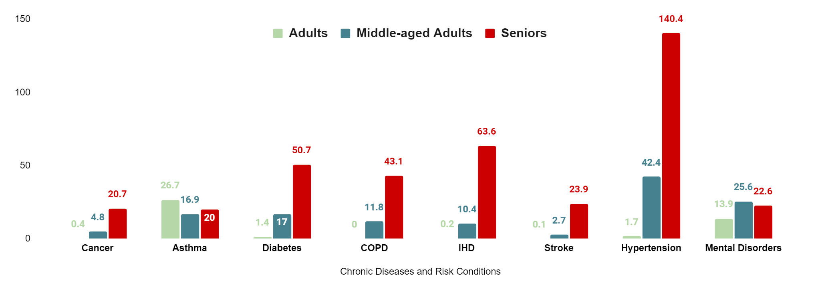
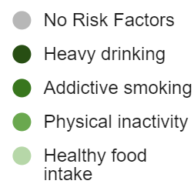
With all the analysis which motivated her to be a healthcare professional, “Barbie” figure out, Canada has little different problem comparatively.
Proportion of the Canadian population 20+ years of age with zero to four of the main modifiable risk behaviors
Hence, these unhealthy habits are leading to chronic diseases among different age groups, as evident in the chart below.
11.2%
19%
2.3%
32.1%
34.8%
Prevalence (%) of major chronic diseases and risk conditions in Canadians, by age group
IHD : Ischemic heart diseases
COPD: Chronic obstructive pulmonary disease
Notes:
With all the analysis which motivated her to be a healthcare professional, “Barbie” figure out, Canada has little different problem comparatively. Canadians are experiencing a higher prevalence of chronic diseases due to unhealthy lifestyles, particularly heavy drinking and smoking, which are significant concerns for the government as shown in the donut chart. The right chart demonstrates the impact of these habits on different age groups and their associated health conditions.

Slide 22
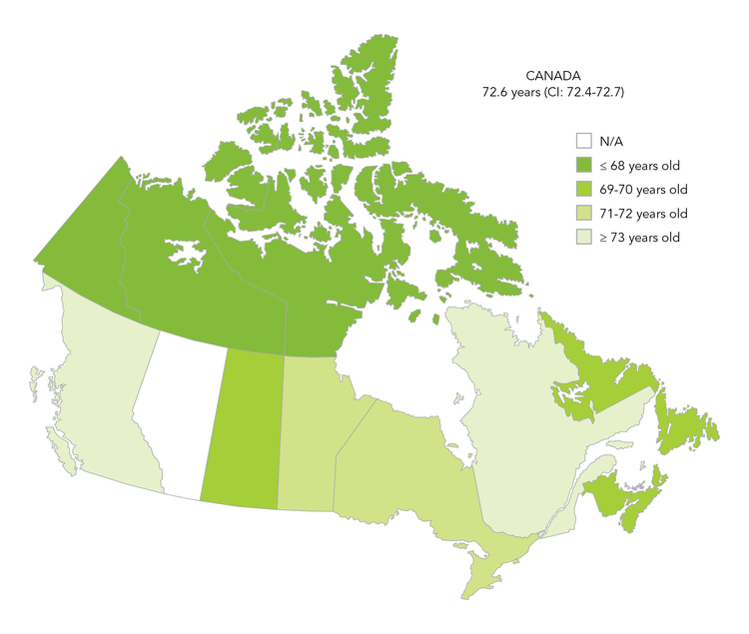
However Canada realises it well and……..
Life expectancy by province and territory, Canada
The Government of Canada has defined three SDG Ambition Statements to guide its efforts in supporting the achievement of this goal:
Canadians Adopt Healthy Behaviours
Canadians Have Healthy and Satisfying Lives
Canada Prevents Causes of Premature Death
Luckily, in Canada, the Life expectancy has grown from 39 years to 77 years from 1831 -2021, with steady increase.
Notes:
However Canada realises it well and…….the government of canada has 3 ambition statements to achieve sdg3. Those are:
Canadians Adopt Healthy Behaviours
Canadians Have Healthy and Satisfying Lives
Canada Prevents Causes of Premature Death
Now lets, Take a moment to compare life expectancy in different provinces.
Luckily, in Canada, the Life expectancy has grown from 39 years to 77 years from 1831 -2021, with steady increase.

Slide 23


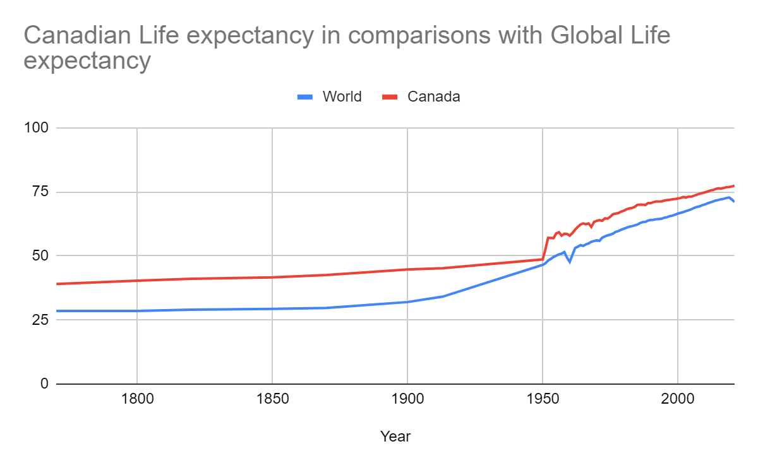
Soo “Barbie” has a conclusion….
Canadians living longer, gender life expectancy gap is closing.
Smoking and chronic disease mortality going down.
Inactivity, sedentary (long time sitting) lifestyle, youth obesity are the growing concerns and needs interventions.
Canadian is 65+
Line graph comparing Canadian Life Expectancy over 1000 live birth with World’s
77 years
Do you know?
72 years
Physical activity can reduce chances of death by 30%
Notes:
Soo “Barbie” has a conclusion….
Canadians living longer, gender life expectancy gap is closing.
1 in 6 canadian is 65+
Smoking and chronic disease mortality going down.
Inactivity, sedentary (long time sitting) lifestyle, youth obesity are the growing concerns and needs interventions.
Do you know, physical activity can reduce chances of deaths by 30%.

Slide 24
Call to Action for:
Support Healthcare for All
Promote Healthy Living
Promote Global Health Equity
Support Mental Health
Encourage Preventive Care and Support Vaccination
Notes:
On the basis of this analysis, call for action can be concluded on 5 simple steps.
Support Healthcare for All
Promote Healthy Living
Promote Global Health Equity
Support Mental Health
Encourage Preventive Care and Support Vaccination

Slide 25
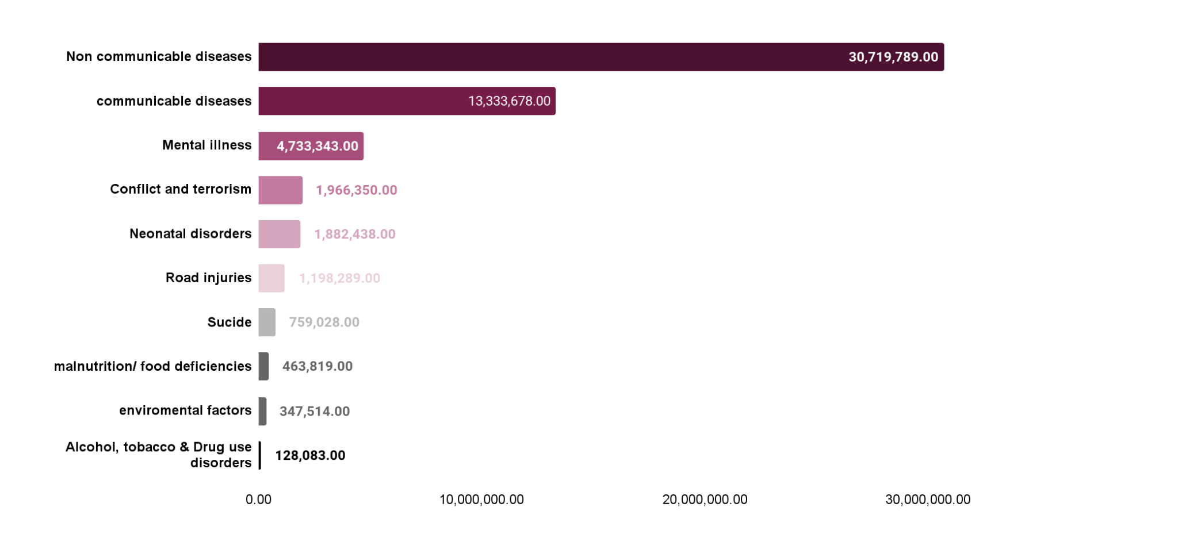
So till now if you might have noticed, “Barbie” discussed with us all the humanly possible ways to have “premature deaths”.
…and it looks something like this…..
Do you know?
Today, 95% of global population suffers from health problem.
Notes:
So till now if you might have noticed, “Barbie” discussed with us all the humanly possible ways to have “premature deaths”.
and it looks something like this….. Do you know , Today, 95% of global population suffers from health problem.

Slide 26
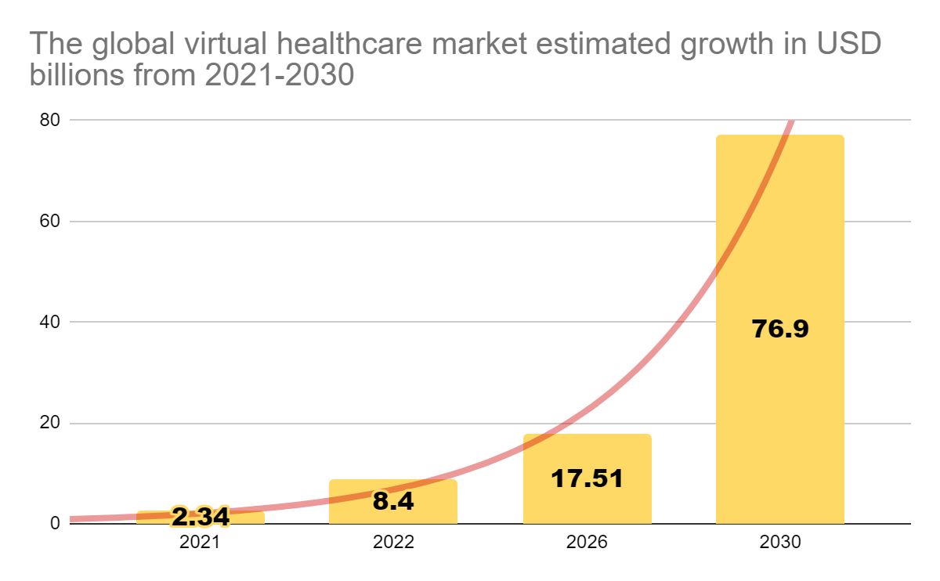
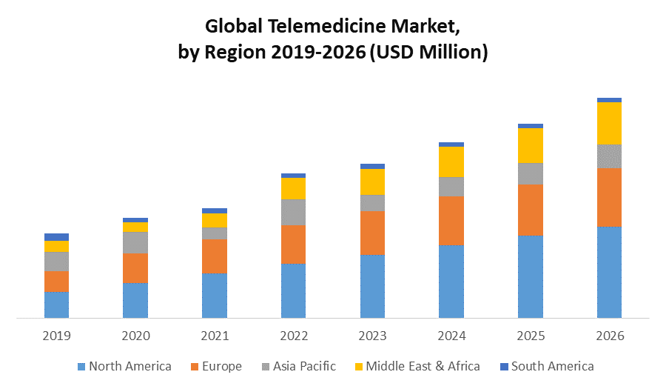
Virtual Care in Global Market
The global virtual healthcare market is estimated to grow from USD 2.34 Billion in 2021 to USD 76.9 Billion by 2030 with compound annual growth rate of 34.20%
Graph 6: Global Telemedicine market
Graph 5: forecast of virtual care market globally
https://www.globalmarketestimates.com/market-report/global-virtual-healthcare-market-2657

Slide 27
By 2030, the United Nations wants to make a plan that looks at many different health problems together, like helping gender, race, preventing diseases, and making sure everyone can get healthcare. This plan is meant to make the world healthier and fairer for everyone.
Notes:
So, the purpose of SDG3 is By 2030, the United Nations wants to make a plan that looks at many different health problems together, like helping gender, race, preventing diseases, and making sure everyone can get healthcare. This plan is meant to make the world healthier and fairer for everyone.

Slide 28


Thank-you
Remember: every individual actions can collectively have a significant impact on achieving SDG 3.

